Slide 1
Chapter 3 Regular Expressions and Languages
Conducted By:
Dr. Amran Hossain
Professor
Department of CSE, DUET, Gazipur

Slide 2
Regular Expressions(RE)
Regular expression(RE) is an expression that specifies a set of strings.
Regular expression provides a flexible means to match string of text, such as particular character, words or pattern of characters.

Slide 3
Operators of Regular expression
Regular expressions denote languages.
For a simple example, the regular ex­pression 01* + 10* denotes:
the language consisting of all strings that are either a single 0 followed by any number of 1's or a single 1 followed by any number of O's.

Slide 4
Operators of Regular expression
1. The Union of two languages L and M, denoted L U M , is the set of strings that are in either L or M, or both.
For example , if L = {001, 10,111} and M = {ε, 001}, then L U M = {ε, 10,001,111}.

Slide 5
Operators of Regular expression
2. The concatenation of languages L and M is the set of strings that can be formed by taking any string in L and concatenating it with any string in M.
We denote concatenation of languages either with a dot or with no operator at all, although the concatenation operator is frequently called "dot .“
For example , if L = {001, 10,111} and M = {ε, 001}, then
L.M, or just LM, is {001, 10,111, 001001, 10001, 111001}.

Slide 6
Operators of Regular expression
3. The closure (or star, or Kleene closure) of a language L is denoted L* and represents the set of those strings that can be formed by taking any number of strings from L, possibly with repetitions (i.e., the same string may be selected more than once) and concatenating all of them.
For instance:
IF L = {0, 1}, then L* is all strings of O's and 1’s.
If L = { 0, 11}, then L* consists of those strings of O's and 1's such that the 1’s come in pairs,
E.g., 011, 11110, and ε, but not 01011 or 101.

Slide 7
Operators of Regular expression
3. The closure (or star, or Kleene closure) More Example:
Let us study a few examples. First , Let L = { O, 11}. L⁰= {ε}.
L¹ = L, which represents the choice of one string from L. Thus, the first two terms in the expansion of L* give us {ε, 0, 11}.
L² = {00,011, 110, I111}.
Similarly, L³ is the set of strings that may be formed by making three choices of the two strings in L and gives us:
{000,0011,0110,1100,0111,11011,1111,0llllll}

Slide 8
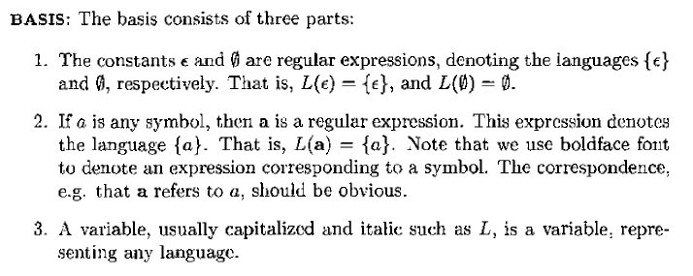
Building a Regular expression

Slide 9
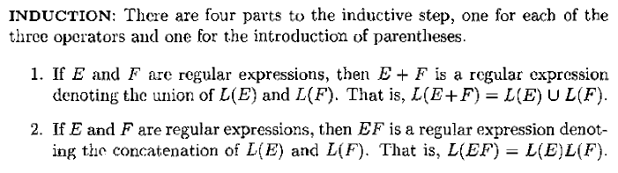
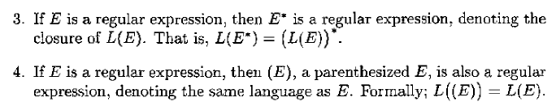
Building a Regular expression

Slide 10
Building a Regular expression
Example 3.2: Let us write a regular expression for the set of strings that consist of alternating 0's and 1’s.
Step-1:
The basis rule for regular expressions tells us that 0 and 1 are expressions denoting the languages {0} and { 1}, respectively.
If we concatenate the two expressions, we get a regular expression for the language {01}; this expression is 01.

Slide 11
Building a Regular expression
Example 3.2: Let us write a regular expression for the set of strings that consist of alternating 0's and 1’s.
Step-2:
Now, to get all strings consisting of zero or more occurrences of 01, we use the regular expression (01)*.
Step 3 : However, L((Ol)*) is not exactly t.he language that we want. It include only those strings of alternating 0’s and l's that begin with 0 and end with 1 and Vise versa

Slide 12
Building a Regular expression
Example 3.2: Let us write a regular expression for the set of strings that consist of alternating 0's and 1’s.
Step 3 : However, L((Ol)*) is not exactly the language that we want. It include only those strings of alternating 0’s and l's that begin with 0 and end with 1 and Vise versa
Step 4: That is, (10)* represents those alternating strings that begin with 1 and end with 0, while 0(10)* can be used for strings that both begin and end with 0 and 1(01)* serves for strings that begin and end with 1. The entire regular expression is:
(01)* + (10)* + 0(10)* + 1(01)*

Slide 13
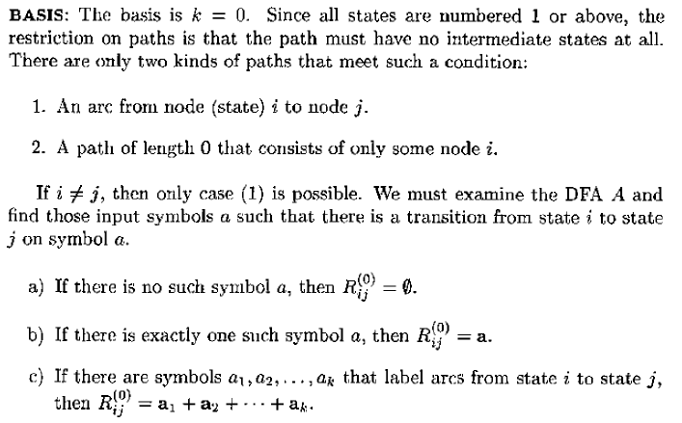
DFA to regular Expression

Slide 14
DFA to regular Expression

Slide 15
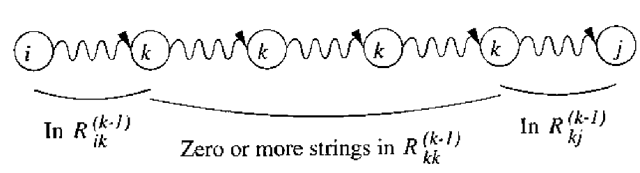

DFA to regular Expression

Slide 16
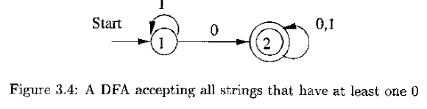
DFA to regular Expression

Slide 17
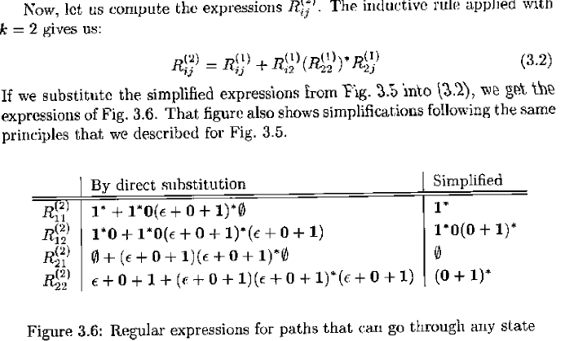
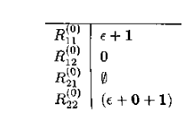

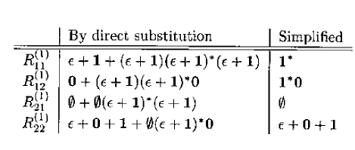
DFA to regular Expression
Solution:
BASIS PART:
Induction PART:
The rule for computing the expressions R^{(k)}_{ij} are instances of the general rule given in the inductive part of Theorem 3.4:

Slide 18
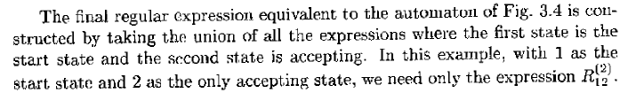
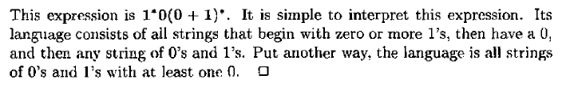
DFA to regular Expression

Slide 19
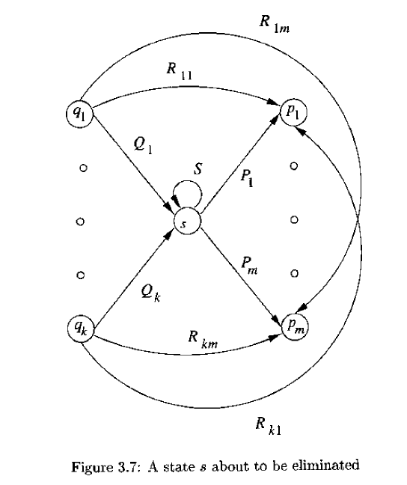
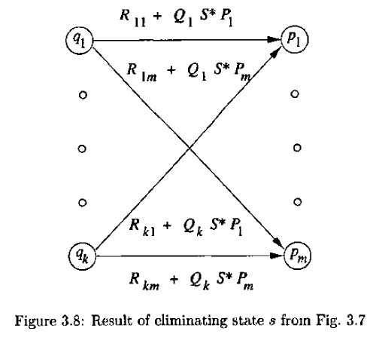
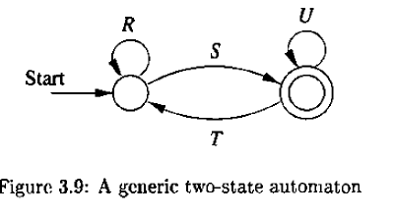
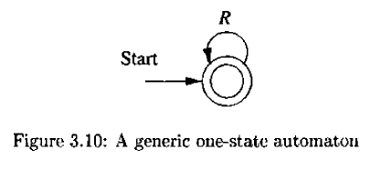
Converting DFA’s to regular expression by eliminating states

Slide 20
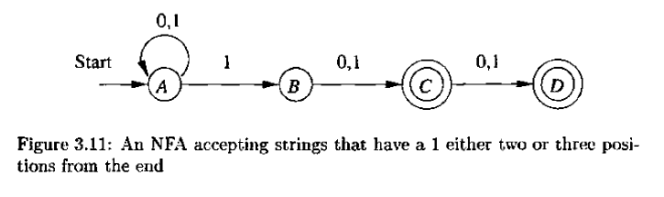
Converting DFA’s to regular expression by eliminating states

Slide 21
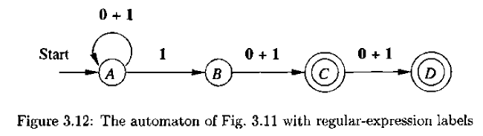
Converting DFA’s to regular expression by eliminating states
Step-1: Our first step is to convert it to an automaton with regular expression labels.
Since no state elimination has been performed, all we have to do is replace the labels "0,1" with the equivalent regular expression 0 + l. The result is shown in Fig. 3.12.

Slide 22
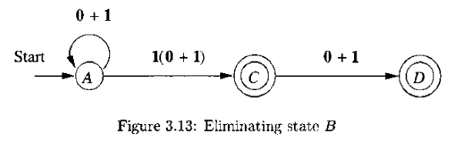
Converting DFA’s to regular expression by eliminating states
Step 2: Let us first eliminate state B. Since this state is neither accepting nor the start state, it will not be in any of the reduced automata. Thus, we save work if we eliminate it first, before developing the two reduced automata that correspond to the two accepting states.
Figure 3.13

Slide 23
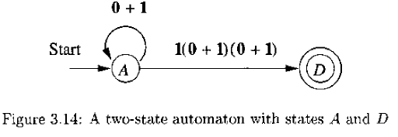

Converting DFA’s to regular expression by eliminating states
Step-3: Now, we must branch, eliminating states C and D in separate reductions. To eliminate state C, the mechanics are similar to those we performed above to eliminate state B, and the resulting automaton is shown in Fig. 3.14.
Regular Expression After deleting C:

Slide 24
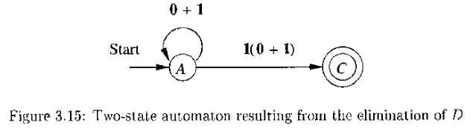

Converting DFA’s to regular expression by eliminating states
Step-4: Now, eliminate state D, the mechanics are similar to those we performed above to eliminate state B, and the resulting automaton is shown in Fig. 3.15.
Regular Expression After deleting D:
Finally, All that remains is to sum the two expressions to get the expression for the entire automaton of Fig. 3.11.
This expression is:

Slide 25
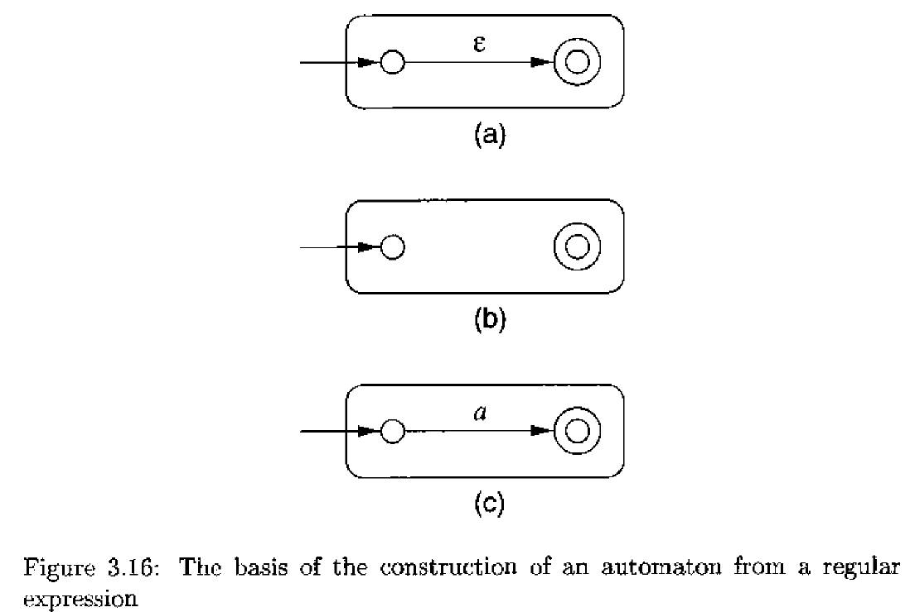
Converting regular expression to automata
BASIS:

Slide 26
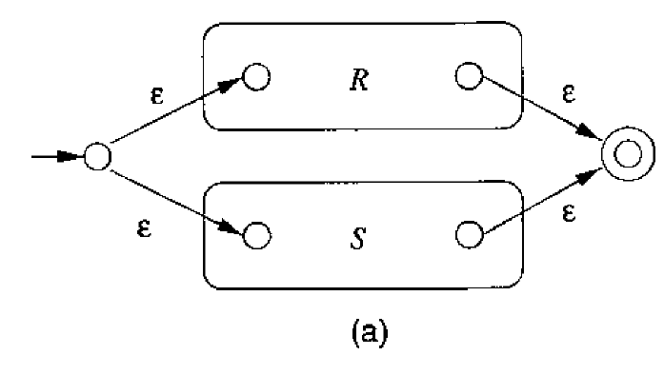
Converting regular expression to automata
Induction:
(1) 1. The expression is R + S for some smaller expressions R and S. Then the automaton of Fig. 3.l 7(a) serves.

Slide 27
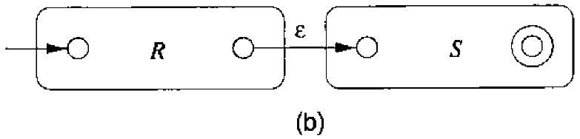
Converting regular expression to automata
Induction:
(2) The expression is RS for some smaller expressions R and S. The automa­ton for the concatenation is shown in Fig. 3.17(b).

Slide 28
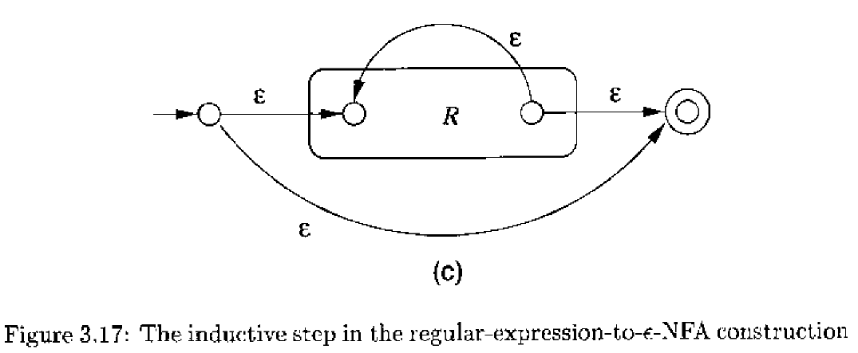
Converting regular expression to automata
Induction:
(3) The expression is R* for some smaller expression R. Then we use the automaton of Fig. 3.17(c).

Slide 29
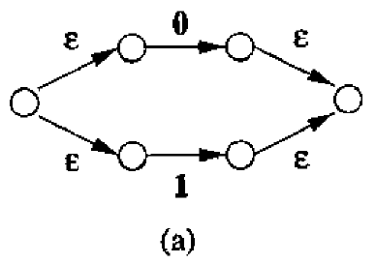
Converting regular expression to automata
Example 3.8 : Let us convert the regular expression (0 + 1)• 1(0 + 1) to an ε-NFA.
Solution:
1) Our first step is to construct an automaton for 0 + 1.

Slide 30
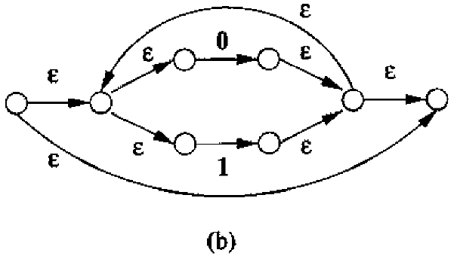
Converting regular expression to automata
Example 3.8 : Let us convert the regular expression (0 + 1)• 1(0 + 1) to an ε-NFA.
Solution:
2) Next, we apply to Fig. 3.18(a) the star construction. This automaton is shown in Fig. 3.18(b).

Slide 31
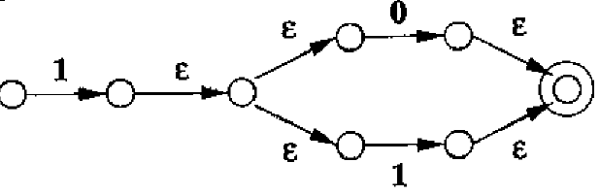
Converting regular expression to automata
Example 3.8 : Let us convert the regular expression (0 + 1)• 1(0 + 1) to an ε-NFA.
Solution:
3) Next, Construct 1(0 + 1)

Slide 32
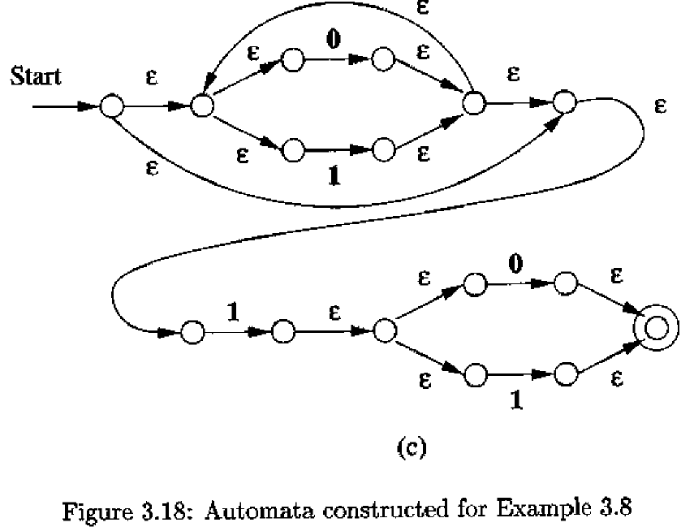
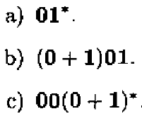
Converting regular expression to automata
Example 3.8 : Let us convert the regular expression (0 + 1)• 1(0 + 1) to an ε-NFA.
Solution:
4) Final ε-NFA.
Try Yourself:

